Slide 1

DATA science bootcamp Capstone
CHONG Kian Boon

Slide 2
Problem Statement
Car insurance provides vehicle owners financial protection against medical and liability costs arising from traffic incidents.
Using given data(features and target), develop a model using machine learning to predict whether an individual will or will not make claim.
To improve from baseline prediction model by tuning hyper-parameter, on whether a car insurance claim was made with given features.

Slide 3
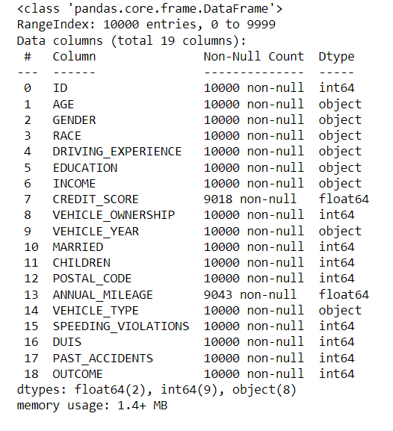
Dataset Overview(1)
Obtained from https://www.kaggle.com/datasets/sagnik1511/car-insurance-data
10000 records with 19 features

Slide 4
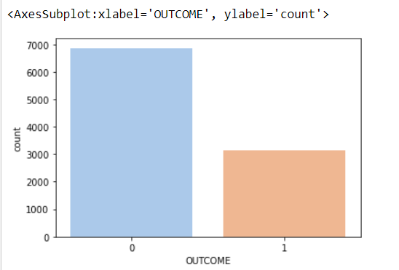
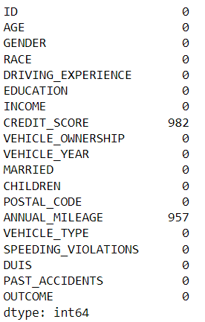
Dataset Overview(2)
Outcome of 1 means insurance was claimed while 0 mean insurance no claim
68.67% did not make claim while 31.33 made claim
There some null values in data

Slide 5
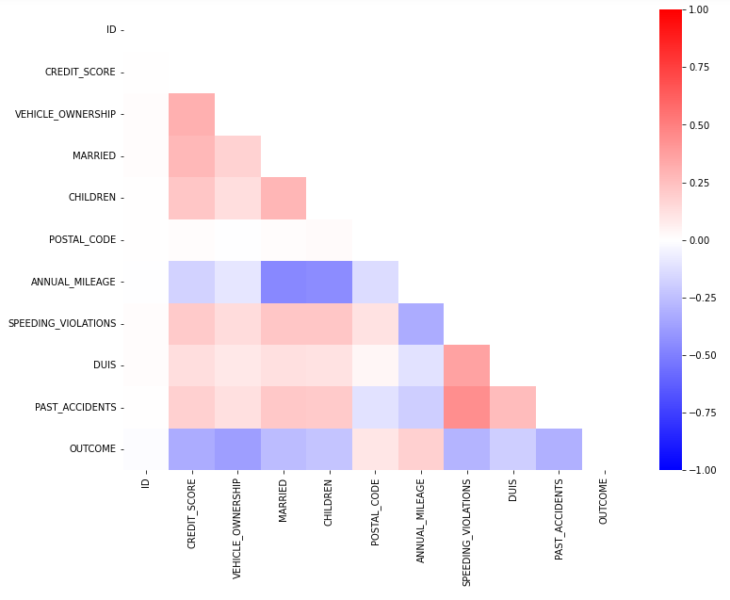
Dataset Overview(3)
From the correlation matrix, we can see that there is no Multicollinearity present.
Will remove ID and postal code during data cleaning process.

Slide 6
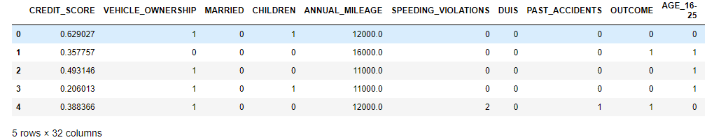
Data cleaning
ID and postal code column removed since they have no correlation with OUTCOME
Filled NULL values in CREDIT_SCORE and ANNUAL_MILEAGE columns using their means respectively
Converted categorial features via One-Hot Encoding so that all features can be used in classification models. (A snip of data below)

Slide 7
Modelling using Decision Tree
Since this is a classification problem, we will be using Decision Tree model
As dataset is inbalanced(about 2/3 with outcome of 0), SMOTE oversampling method was used to create a balanced training data
80% of dataset is split out to be used as training data set for modelling
Baseline Decision Tree Model using default hyper-parameters, gave me an accuracy of 77.75% (predicted outcome results vs test outcome )

Slide 8
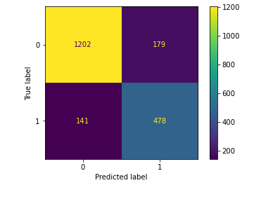
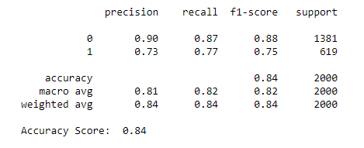
Using Gridsearch to improve model
Employed Gridsearch to seek out best combination of hyper-parameters for the decision tree model
Improved model achieved 84% accuracy from baseline(77.7%)

Slide 9
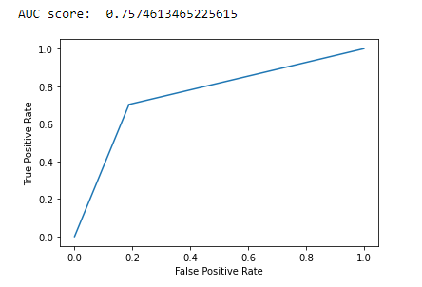
Conclusion
From the accuracy score, AUC score, precision score, and recall score and that the ROC Curve hugs left, we can conclude that the model fits our dataset welI.
This model is suitable for predicting whether an individual will make claim based on the feature variables

